Slide 1

Designing Stable, Non-Speculative Incentives for Sustainable Agriculture using IoT and Distributed Ledgers
Candidate: Abedalrahman )Abdu) Chams Aldeen

Slide 2

About The Candidate
MSc Agricultural Engineering – Politecnico di Milano.
Precision Agriculture & IoT – Industrial Technologies for Precision Agriculture & Smart irrigation systems
Systems & Stability – Control Systems for Smart Agriculture, Analysis II
Data & Modeling – Data Harvesting & Data Analysis for Agriculture
Adoption & Policy – Agri-Food Supply Chain Management, Economics & Policy for Agriculture
Sustainability – Sustainability Assessment in Agriculture
Master’s Thesis: Designing Stable, Outcome-Linked Incentive Mechanisms for Sustainable Nitrogen Management Using IoT and Blockchain

Slide 3
A Dual Crisis in Agriculture
Ecological Angle:
70% of global freshwater is used by agriculture → AgriLiraX incentivizes precision irrigation.
78% of eutrophication comes from agriculture → AgriLiraX rewards smart fertilization.
Economic Angle:
Farmers face thin margins → AgriLiraX reduces adoption risk.
Food systems impose $10–12.7T/year in hidden costs → AgriLiraX links value to solutions.
Only 20% of land is irrigated but produces 40% of food → AgriLiraX accelerates investment in irrigation.

Slide 4
Why Current Solutions Fall Short
Problems with Subsidies
Reward actions, not outcomes → Most agri-environmental payments are practice-based and underperform; OECD recommends moving to results-based/hybrid. (OECD)
Favor large farms → ~20% of farms capture ~80% of EU CAP direct payments; similar concentration seen in US programs. (EU Commission, USDA)
Slow & bureaucratic → CAP “greening” added complexity but little impact (~5% farmland affected); limited real-time feedback. (EU Auditors, OECD)

Slide 5
Why Current Solutions Fall Short
Problems with Crypto in Ag
Speculation over utility → Much attention goes to tradable tokens (e.g., Agrotoken); non-token blockchain pilots (traceability, record-keeping) remain small. (World Bank, FAO)
Volatility farmers can’t absorb → Cryptoassets are highly volatile; risky for working capital/input purchases. (BIS, IMF)
Limited real-world impact → Many pilots remain early-stage, focused on traceability; farm-level benefits still small. (FAO, systematic reviews)

Slide 6
The Solution: An Outcome-Linked Utility Token
Core Properties:
Outcome-Linked: Minted only for verified improvements (e.g., nitrogen-use efficiency).
Non-Tradable: No secondary market, preventing speculation.
Redemption-Backed: Each token can be redeemed against a central program fund for a fixed service credit or rebate value, capped to ensure stability (e.g., up to €1 equivalent per token)
Program-Controlled Dynamics: Redemption value can adjust between periods (based on budgets/outcomes), but never through market trading.

Slide 7
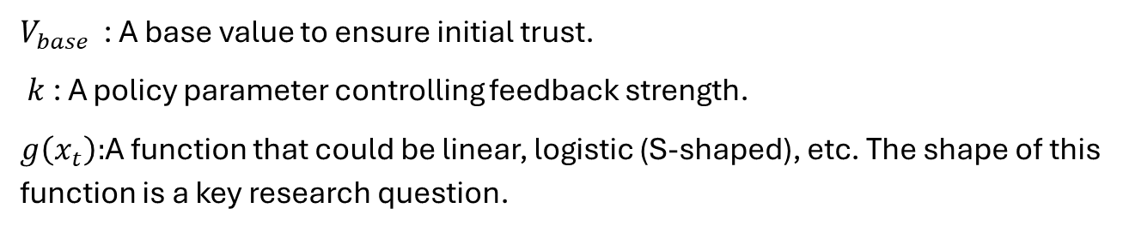
Mechanism Design: A Dynamic, Adoption-Linked Value
The token’s redemption value is rule-based, not market-priced. It evolves as a direct function of system-wide adoption outcomes and program budget, creating a feedback loop that rewards participants as the network succeeds — while remaining non-tradable and stable.
$$Vt=V_{base }+k. g(x_{t})$$
$V_{base }$​: A base value to ensure initial trust.
$k$: A policy parameter controlling feedback strength.
$g\left(x_{t}\right):$A function that could be linear, logistic (S-shaped), etc. The shape of this function is a key research question.
*(The redemption value is backed by a central Ecosystem Fund, ensuring farmers can always claim a minimum level of services or support)

Slide 8
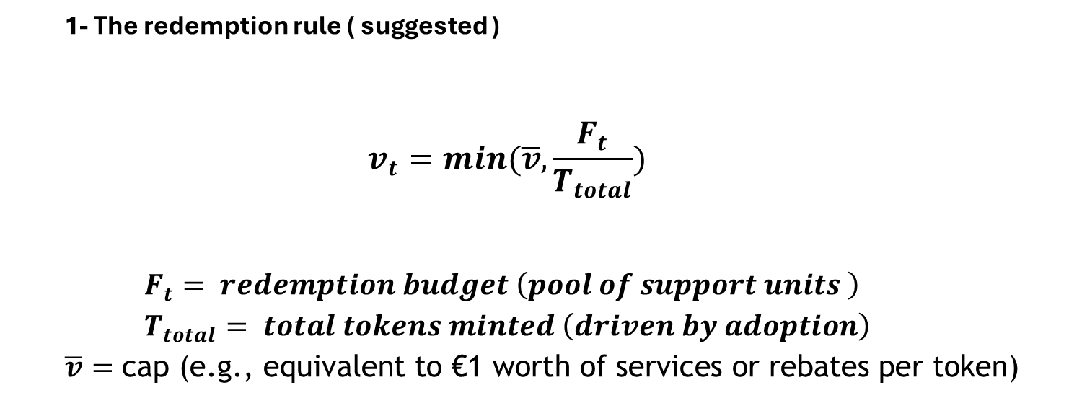
How Tokens Are Minted and Redeemed
1- The redemption rule ( suggested )
$$v_{t}=min(\overline{v},\frac{F_{t}}{T_{total}})$$
$$F_{t}= redemption budget \left(pool of support units \right) \\ T_{total}= total tokens minted \left(driven by adoption\right)$$ $\overline{v}=\text{cap}\text{ (}\text{e}\text{.}\text{g}\text{., }\text{equivalent} \text{to}\text{ €1 }\text{worth} \text{of} \text{services} \text{or} \text{rebates} \text{per} \text{token}\text{)}$
Total payouts can never exceed the budget.
Every farmer gets the same transparent rate.
Optional smoothing function keeps values stable over time.

Slide 9
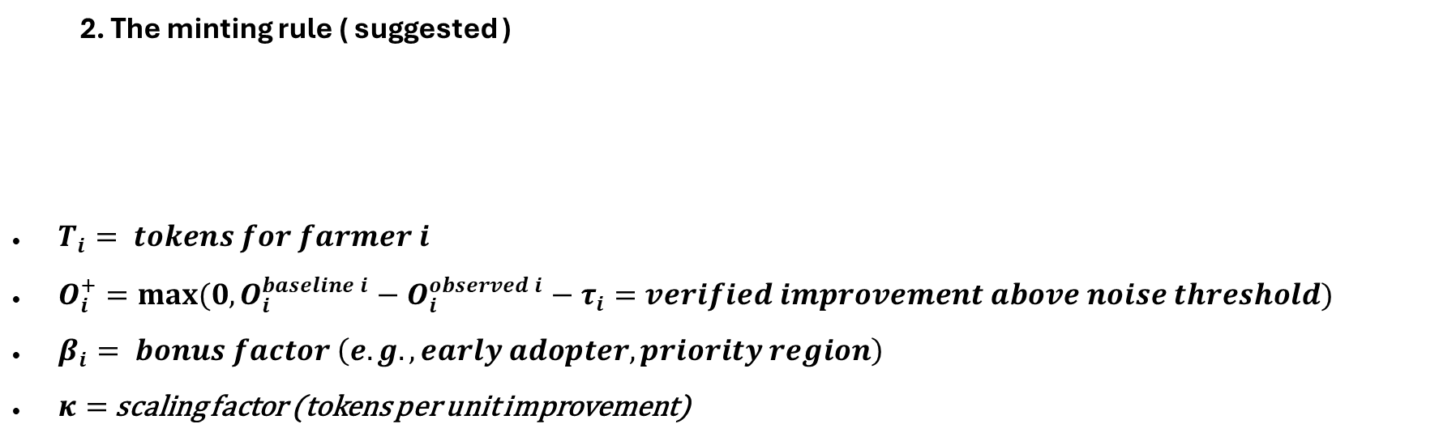
How Tokens Are Minted and Redeemed
2. The minting rule ( suggested )
$T_{i}= tokens for farmer i$
$O_{i}^{+}=max⁡(0,O_{i}^{baseline i}−O_{i}^{observed i}−τ_{i}=verified improvement above noise threshold)$
$β_{i}= bonus factor \left(e.g., early adopter, priority region\right)$
$κ=$scaling factor (tokens per unit improvement)
$$T_{i}​=κ β_{i}​ ΔO_{i}^{+}​$$
Based on verified improvements (sensors + baseline).
Includes thresholds and audits to prevent gaming.
Bonus factors reward early adopters or priority regions.

Slide 10
Mechanism
How Value Is Redeemed (Budget Safety & Stability)
Redemption is capped, budget-safe, and stable.
Treasury fund sets max payout per cycle.
Per-token redemption credit = min(cap, Fund ÷ Tokens), where the cap is set to an equivalent of €1 worth of services or benefits.
Every farmer redeems at the same rate (transparent & fair).
Always within budget; smoothing dampens volatility.

Slide 11
Mechanism
How It Works (Minting & Verification)
Reward only verified, mesurable improvements.
Farmers submit IoT data → compared to modeled baseline
Only positive, significant outcomes count (noise filter + audits)
Tokens minted proportional to verified impact × bonus factors
Tokens are non-tradable, tied to farmer identity

Slide 12
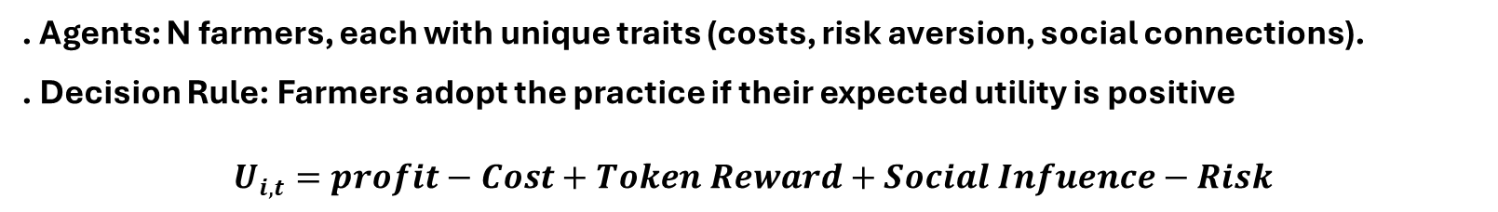
Methodology: Agent-Based Model (ABM)
I will use a bottom-up simulation to explore how diverse farmers react to this new incentive.
. Agents: N farmers, each with unique traits (costs, risk aversion, social connections).
. Decision Rule: Farmers adopt the practice if their expected utility is positive
$$U_{i,t}=profit−Cost+Token Reward+Social Infuence−Risk$$
Utility of farmer $i$at time $t$: adoption occurs if expected utility is positive.

Slide 13
Staying Outside MiCA – While Still Paying in Euros
Key Design Choices
Non-transferable tokens
Farmers cannot trade or sell tokens to others.
Tokens act as reward points tied to verified outcomes.
Variable redemption (no fixed €1 peg)
Euro payout = Budget ÷ Total Tokens each cycle.
Value per token adjusts with adoption and available funds.
Avoids “stablecoin” classification.
Framed as a reward program, not digital money
Tokens = claim on sustainability rewards, not a euro substitute.
Euro redemption is described as a rebate / grant payout, not e-money.
Closed network of services + optional cash-out
Primary use: redeem tokens for approved precision-agriculture services.

Slide 14
AgriLiraX: Designed to Avoid Speculation & Volatility
Dimension | AgriLiraX (PhD Token) | Carbon Credits
Purpose | Change farmer behavior by rewarding verified outcomes. | Offset emissions for buyers via reductions/removals.
Transferability | Non-tradable → no speculation. | Tradable → market volatility.
Value setting | Program-defined redemption rate ,1 token = 1 service credit, or capped equivalent | Market price via supply/demand.
Who pays | Ecosystem fund: govt, CSR, insurers, | Offset buyers purchase credits.
Primary research focus | Mechanism design & stability of adoption incentives. | Market design & credit integrity.

Slide 15
Core Research Questions
This project is structured around three possible questions.
How can we design the reward system, so it always stays within budget and still motivates farmers to adopt?
What will farmers actually do when offered tokens they can redeem for useful services or support?
How does this outcome-based token compare to existing tools like carbon credits or traditional subsidies?

Slide 16
Blockchain decision For The Token
Suggested Choice: Ethereum L2 (ZK Rollup)
Why it works well?
Low cost & fast finality: Farmers get rewards cheaply and quickly.
Secure: Inherits Ethereum’s battle-tested security.
Scalable: Can handle IoT-scale adoption.
Trustworthy: Validity proofs mean no need to “trust” sequencers.
Regulatory fit: Supports non-tradable, utility-only tokens.

Slide 17
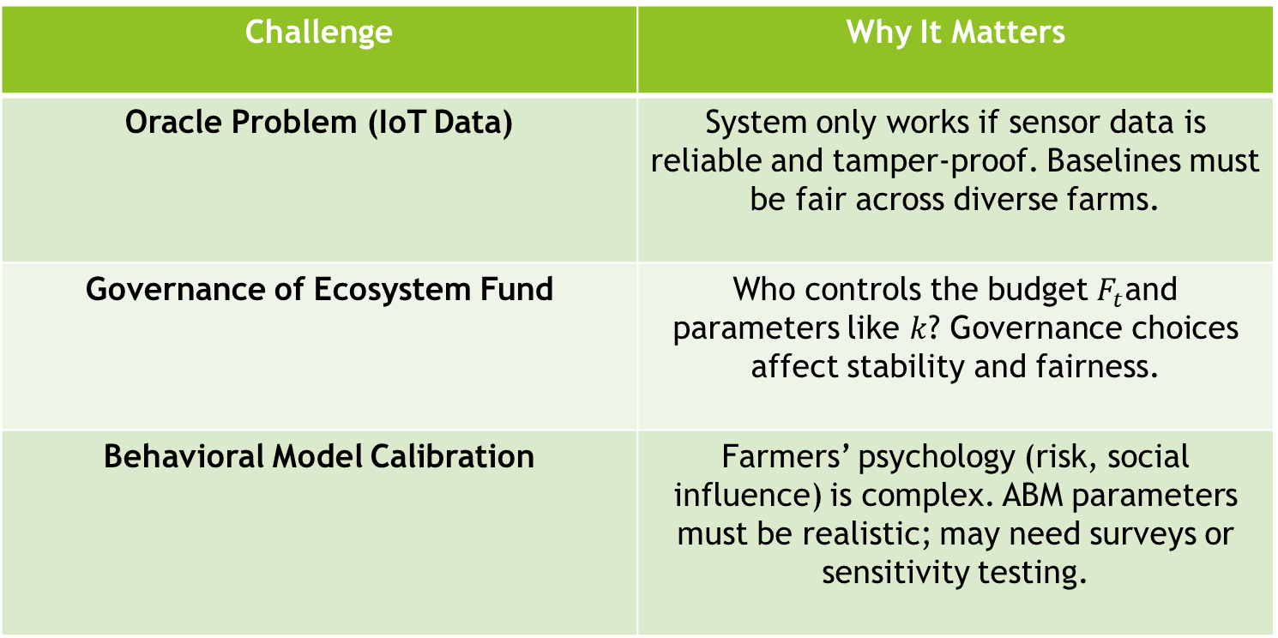
Key Research Challenges
Challenge | Why It Matters
Oracle Problem (IoT Data) | System only works if sensor data is reliable and tamper-proof. Baselines must be fair across diverse farms.
Governance of Ecosystem Fund | Who controls the budget $F_{t}$and parameters like $k$? Governance choices affect stability and fairness.
Behavioral Model Calibration | Farmers’ psychology (risk, social influence) is complex. ABM parameters must be realistic; may need surveys or sensitivity testing.

Slide 18
Recognized by leading experts in digital finance and complex systems
This project has attracted early interest and recognition from prominent scholars in the fields of economics, complex systems, and blockchain innovation, including:
Prof. Paolo Tasca — Digital economy & blockchain policy (Previously UCL)
Prof. Christian Catalini — Crypto economics & incentive design (MIT)
Prof. Didier Sornette — Complex systems & risk modeling (Previously ETH Zurich)
Prof. Garrick Hileman — Cryptocurrency adoption & macro-financial systems

